Slide 1

TaskVault Coral
Organize Teams, Track Workflows, See What Matters
Presenter | January 2026

Slide 2
What is TaskVault Coral
⚙️
🔒
📈
Centralized Management
Secure by Default
Scalable
Grows with your team
All workflows in one place
Enterprise-grade security

Slide 3
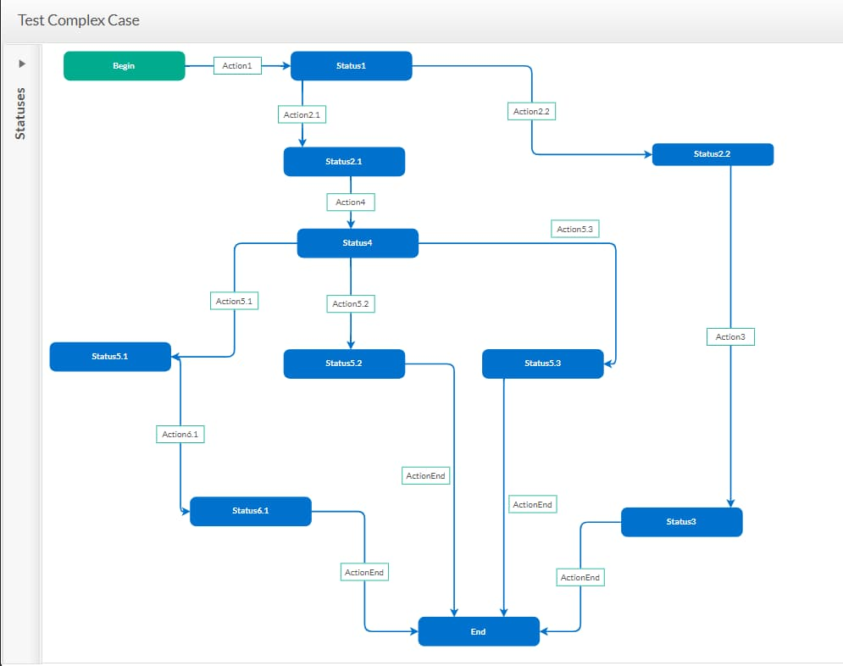
Homepage & Authentication
Clean, intuitive landing page
Email & password login
Secure access with best practices

Slide 4
Account & Subscription
Profile management
Free plan for small teams
Pro plan with advanced features
Upgrade anytime

Slide 5
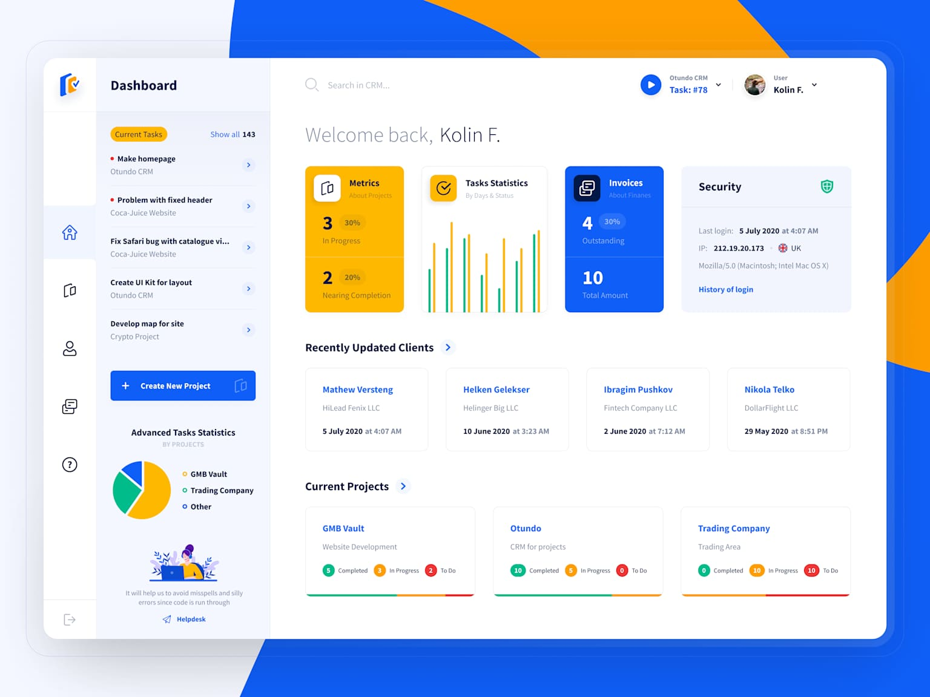
Workflows
Create repeatable workflows
Assign steps to team members
Track progress in real-time

Slide 6
Team Management
Invite team members
Assign roles and permissions
Permission control at granular level
Role-based access

Slide 7
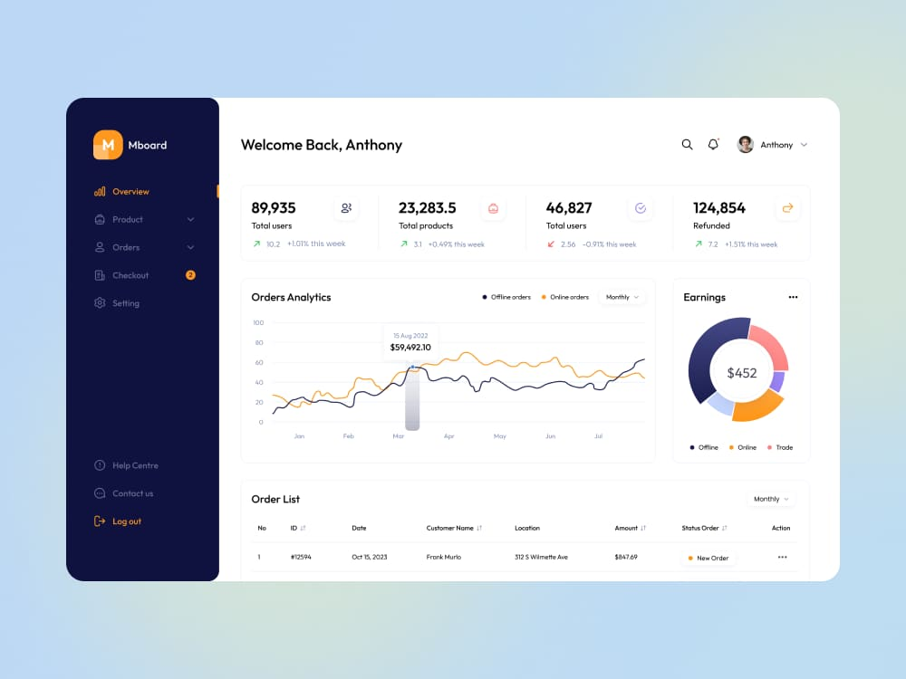
Analytics Dashboard
Workflow status overview
Team activity insights
Bottleneck detection & metrics

Slide 8
Admin & Audit
Comprehensive audit logs
Admin-only access controls
Governance-ready compliance
Full traceability

Slide 9
Live Demo Flow
Authentication and login
Create workflow
Invite team members
View dashboard

Slide 10

Summary & Q&A
⚡
🛡️
👥
Lightweight & Scalable
Secure & Modern
Built for Teams
Questions?

